Slide 1


TRUSTED NOTIFICATION SYSTEM
A reliable, safe, and timely notification delivery platform with intelligent routing, spam filtering, and comprehensive retry mechanisms
By Sahid Ahmed Laskar
Roll No.: CU.06
College: COTTON UNIVERSITY
Course: Master’s of Computer Application
sahidahmed24680@gmail.com
Mentor: Neetesh Bhardwaj

Slide 2
EVENT CLASSIFICATION FRAMEWORK (MASTER SHEET)
Objective of Event Classification
The objective of this section is to categorize all notification event types using a structured and data-backed model. This classification helps in:
Selecting the optimal primary channel
Designing the right fallback sequence
Prioritizing events requiring Secure Inbox storage
Building system-level routing rules
Improving delivery success and customer trust

Slide 3
DATA SOURCES USED
EVENT_TYPE_STATS.XLSX
TRUSTED_NOTIFICATIONS.XLSX
Event volume
Retry frequency
Historical delivery performance
Customer-level notification logs
Intended channel
Delivery outcomes
Retry attempts
Customer actions
These datasets were used to calculate channel performance, engagement trends, and failure patterns.

Slide 4
CLASSIFICATION PARAMETERS
Event Category (Authentication, Security, Transaction, Reminder, Service, Marketing)
Criticality Level (High / Medium / Low)
Risk Level (High / Medium / Low)
Event Count (Volume)
Retry Percentage
Most Common Intended Channel (from actual send data)
Delivery Success Percentage
Customer Action Trend (Viewed, Ignored, Clicked, Reported Spam, Contacted Support)
Priority Score (Risk + Criticality + Delivery Risk)
Recommended Primary Channel
Fallback Channels
Secure Inbox Requirement (Yes, No)

Slide 5
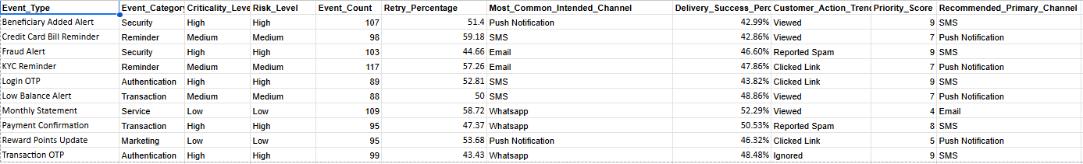
MASTER SHEET SNAPSHORT
The Master Sheet forms the foundation of the Trusted Notification Engine
Master Sheet Link :
https://docs.google.com/spreadsheets/d/1MNocFvaiHe1r0fEUS_cWJG4yPJCrRqJvW3C39--HeA4/edit?usp=sharing

Slide 6
Escalation Logic
Retry Engine
Policy Function
PURPOSE OF MASTER SHEET
Dynamically Provides
Channel priority & fallback ordering
Success Rate Simulation

Slide 7
CHANNEL ROUTING & FALLBACK LOGIC
The system implements a policy-driven routing engine which is derived from Master-Sheet
For each event type, the engine generates:
Primary channel
Ordered fallback channels
Max retry attempts
Critical escalation workflow
Per-channel wait time (latency window)
Secure Inbox requirement

Slide 8
REAL-TIME ROUTING LOGIC
Example from running system:
BENEFICIARY ADDED ALERT (Critical)
Mode: PARALLEL
Channels: PUSH, SMS, EMAIL
Retries: 3 attempts each
Escalation:
→ PHONE_CALL
→ SECURE_INBOX
→ OPS_ALERT
Success-rate used: 48–52% (±5% variation)
Key Behavior in System
All channels fire simultaneously.
The channel with the earliest success stops all others.
If ALL fail → escalation begins.
Missing inputs (e.g., no phone/email) return PERMANENT_FAILURE, still logged.
No channel is skipped — system attempts them all

Slide 9
Automatically escalates failures
Reads channels dynamically per event
Attempts ALL channels unless explicitly excluded
WHAT MAKES THIS ROUTING INTELLIGENT
Logs everything in real-time
Simulates provider reliability with random probability

Slide 10
RETRY LOGIC & ESCALATION (AS IMPLEMENTED IN CODE)
Actual Retry Behavior
For each channel:
for attempt in 1..max_attempts:
send to provider
if delivered:
stop retries
else if permanent failure:
breakelse:
wait and retry
Escalation (As Implemented)
If all channels fail:
log("ESCALATION_TRIGGERED")
update_event_status("ESCALATED")
This maps directly to:
Fraud Ops alerts
Secure Inbox fallback
OPS_ALERT for critical services
Effective Delivery Probability
You implemented enterprise-grade reliability simulation:
effective_rate = configured_rate ± random(0–5%)
delivered = roll <= effective_rate
This mimics real vendor behavior.

Slide 11
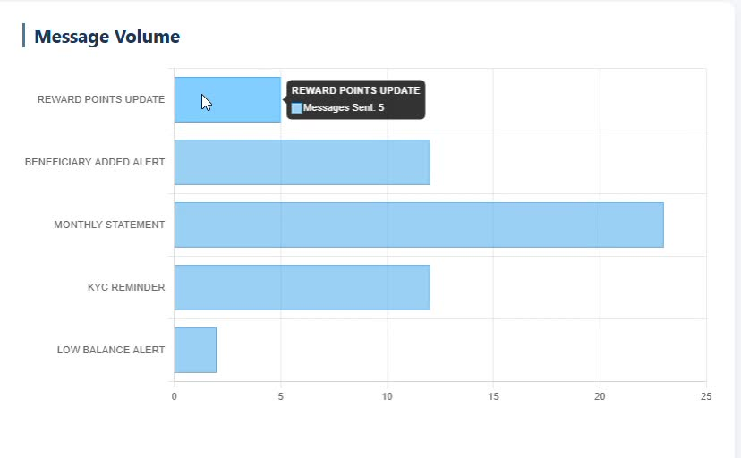
DASHBOARD & ANALYTICS SYSTEM
Tracks all notification attempts: Across SMS, Email, Push, and WhatsApp, including retries, failures, and escalations, providing a complete event-level audit trail
Aggregates volume by event type: Enabling the system to visualize which notifications—such as OTPs, fraud alerts, or reminders—generate the highest load
Provides real-time visualization: Through the dashboard’s bar graph, helping stakeholders monitor system activity, detect anomalies, and maintain end-to-end notification reliability

Slide 12
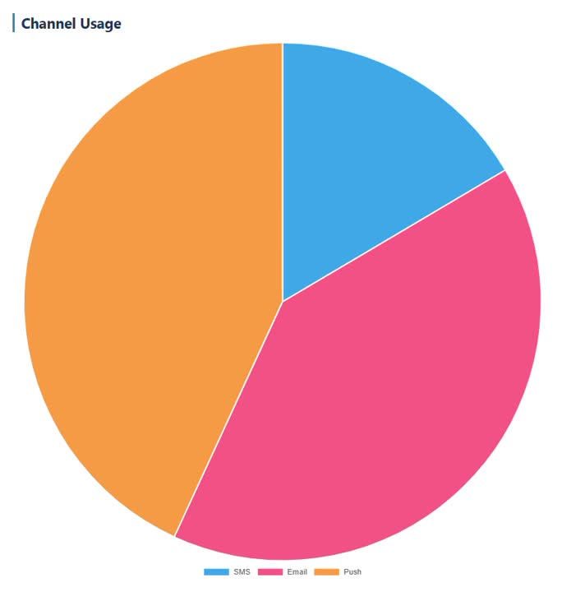
DASHBOARD & ANALYTICS SYSTEM
Visualizes distribution of traffic across channels: The pie chart clearly shows which channels—SMS, Email, Push, WhatsApp—are used most frequently for outbound notifications.
Detects Channel Performance Issues Early: A sudden drop in usage of a major channel (like SMS) indicates provider failures or delivery outages.
Improves Future Capacity & Scalability Planning Understanding long-term usage trends helps decide:
– how many provider integrations are required,
– whether to enable load balancing,
– and how to scale infrastructure for peak traffic.

Slide 13
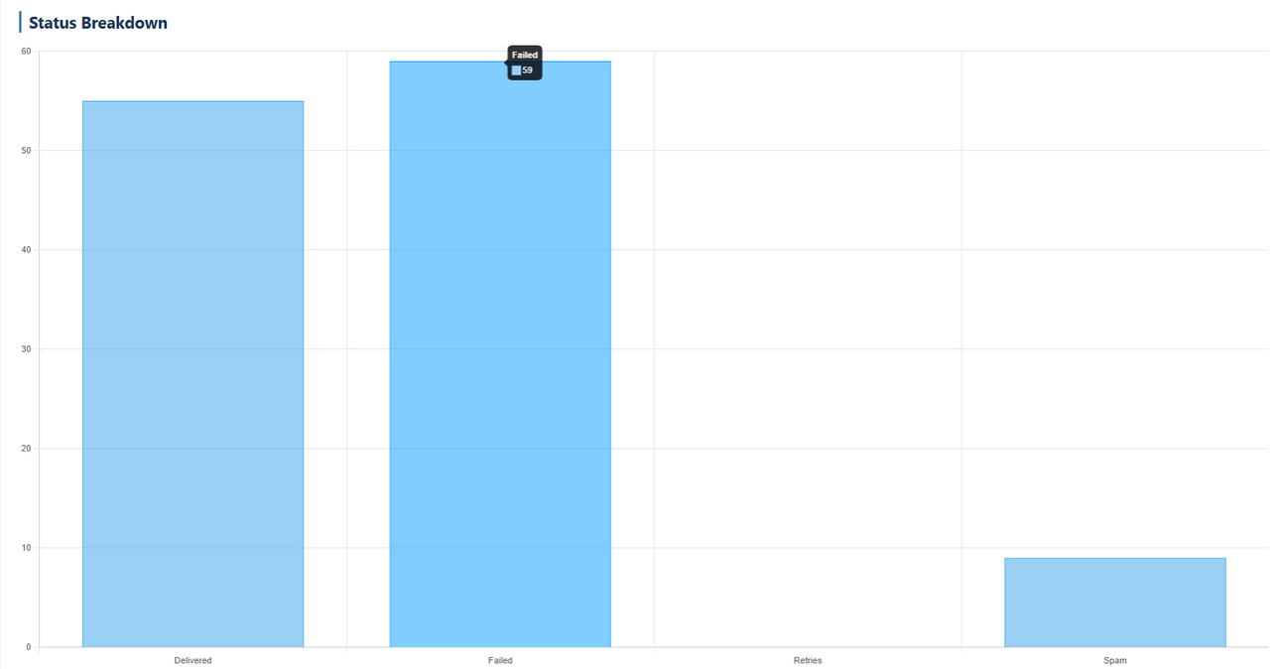
DASHBOARD & ANALYTICS SYSTEM
Gives a Clear Overview of System Activity: The graph visually shows how many notifications were Delivered, Processed, or Categorized as Spam, helping stakeholders quickly understand overall system performance at a glance.
Demonstrates the System’s Ability to Classify Notifications Accurately: Delivered, Failed, Spam—shows that the system is actively tracking and categorizing every message

Slide 14
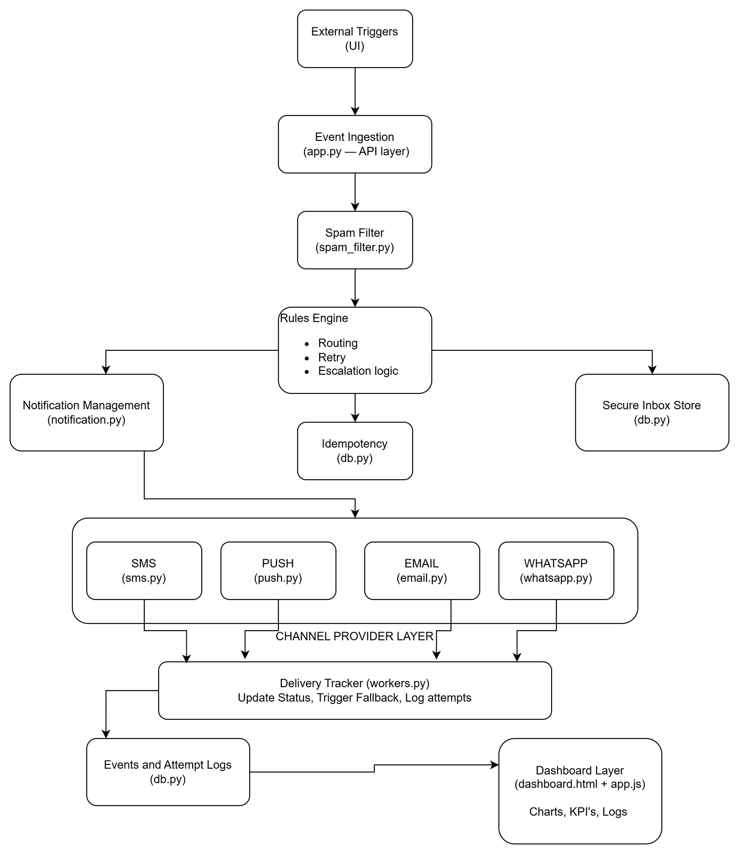
SYSTEM ARCHITECTURE

Slide 15
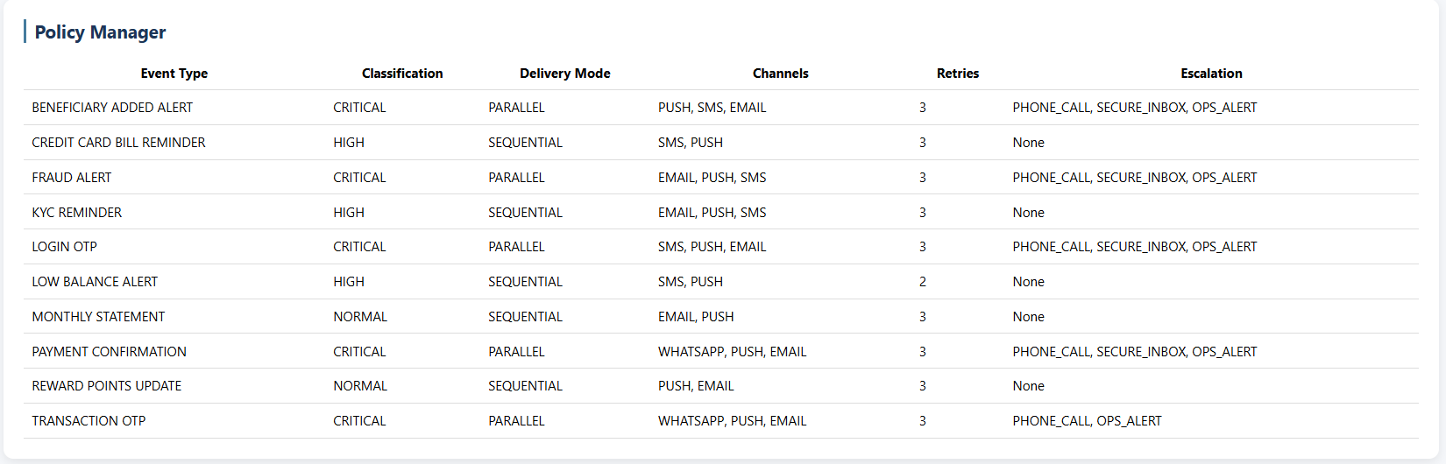
POLICY MANAGER

Slide 16
POLICY MANAGER WORKING
POLICY DECISION FACTORS
Each event type is assigned a Classification (Critical / High / Normal).
A Delivery Mode is defined:
Parallel → All channels attempted at same time
Sequential → Channels attempted one after another
A list of Channels is assigned in priority order.
Retry Count determines how many attempts per channel.
Escalation Rules define what to do if all attempts fail:
Phone Call
Secure Inbox
Ops Alert
The Policy Manager logic is based on:
Risk level of event (e.g. Fraud Alert > Reward Points)
Time sensitivity (OTPs must be instant)
Compliance requirements (Statements → Email)
User trust requirements (Beneficiary Added → Secure Inbox)
Channel reliability & cost

Slide 17
TECH-STACK
Frontend Dashboard
HTML/CSS: ensures clean layout
JavaScript (Chart.js): fetches real-time analytics and logs from Flask backend
Chart.js visualizes:
Channel Usage
Message Volume
Status Breakdown
KPIs (Delivered, Failed, Spam, Success Rate)
Backend
Python:core notification engine, rules engine, retry logic
Flask: API endpoints, Trigger Workflow, Serving policy data to dashboard.
Database: SQLite
Stores: Event logs, delivery attempts, secure inbox messages, retry, analytics data, Idempotency keys, Escalation flags and Status tracking
Provider Layer
Channels include:
SMSProviderMock
EmailProviderMock
PushProviderMock
WhatsAppProviderMock

Slide 18
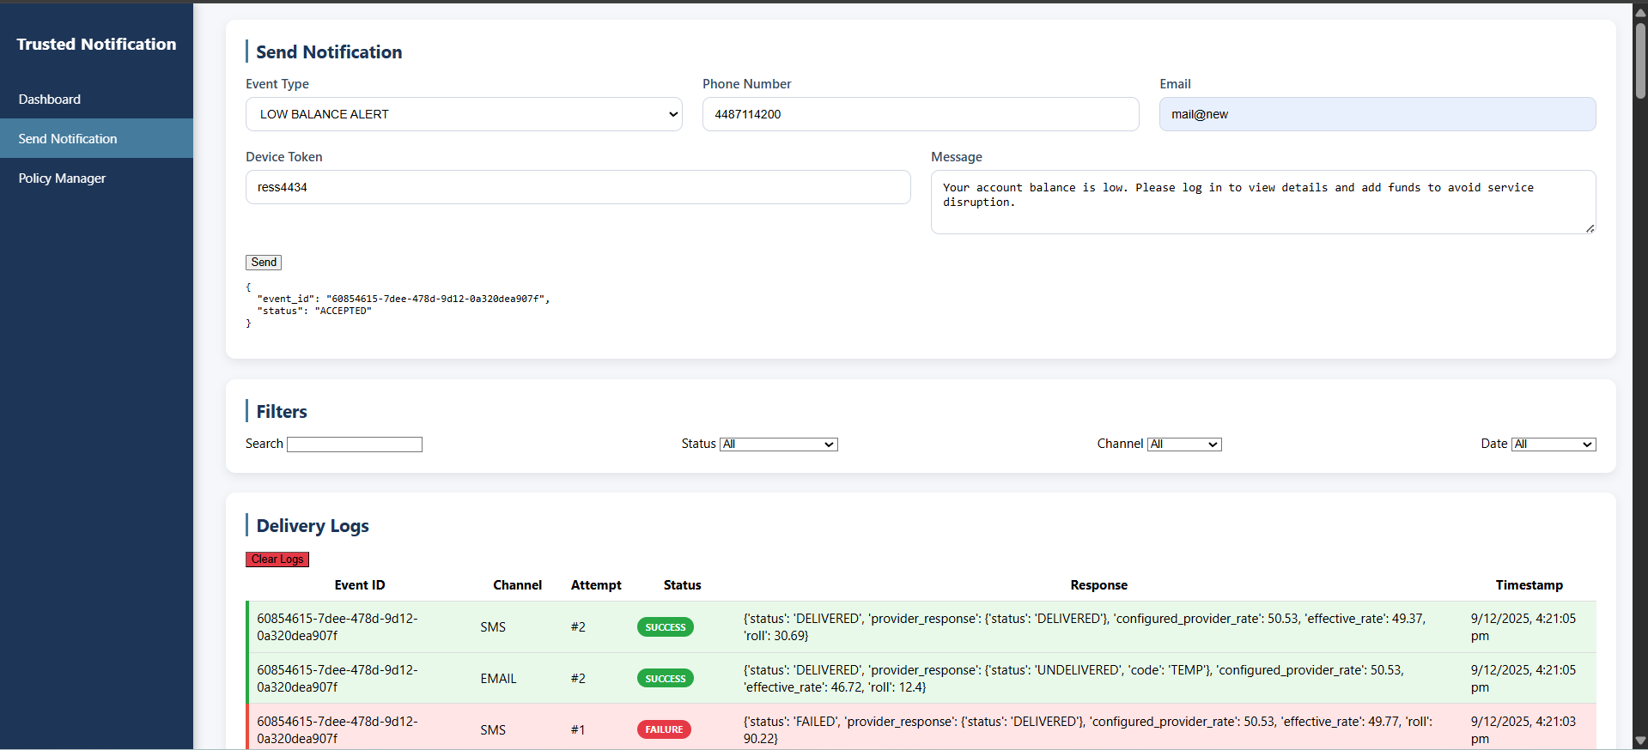
NOTIFICATION CONSOLE

Slide 19
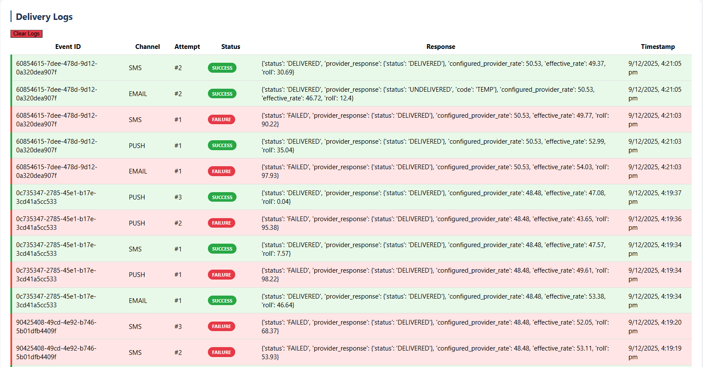
REAL-TIME DELIVERY LOGS

Slide 20
FUTURE ENHANCEMENTS
PostgreSQL/MySQL support
Message queue integration (Celery/RabbitMQ)
Advanced analytics dashboard
A/B testing for delivery channels
ML-based optimal channel selection
Real provider integrations (SendGrid, Twilio, etc.)
WebSocket live notification

Slide 21
THANK YOU
Connect with me:
https://www.linkedin.com/in/sahid-ahmed/

